Slide 1
Zephyrus – Cloud & Task Management Tool
^{Oscar E. Ganteaume}
^{November 2018}

Slide 2
Zephyrus – Cloud & Task Management Tool
Why Zephyrus
Zephyrus’ primarily goal is to abstract and simplify dynamic resource allocation and load balancing by hiding AWS’ inherent complexity.
C2S developers require a streamlined tool to simplify resource allocation, management, and monitoring of mission workloads.
AWS’ overly complicated auto-scaling feature, for example, typically isn’t used because of the complexity in implementing:
- Custom Threshold Metrics - Service Request Roles
- Launch Configurations - Auto Scaling Groups
- Alarm Creation - Policy Creation
Amazon Web Services (AWS’ C2S) provides an excellent cloud infrastructure solution for government enterprises.
  But – AWS mission costs have shown that they far exceed the costs of dedicated stovepipe system costs
    Routine Provisioning of instances for a worst case scenario
    The Elastic Compute cloud (EC2) is charged per usage time even if the EC2 instance is using less than destined capacity or sitting idle.
    Limited Mission Resource Visibility
LGS Innovation has developed, and has a patent pending on technology that will save up to 50% of the AWS compute costs within C2S, DI2E, and GovCloud by dynamically “Right-Sizing” resources & providing visibility in a Cloud agnostic environment

Slide 3
Zephyrus – Cloud & Task Management Tool
Main Objectives
Resource Management
  The Auto Scaling engine analyzes performance metrics and determines when to start or stop virtual machines using cloud services provided API
  Allows customer to add their own resource allocation algorithm through an application programming interface
  Service is cloud provider agnostic and compatible with major cloud providers
  It uses its own algorithms and allows developers to create their own as well, to decide how the tasks need to be allocated (Load Balancing).
  Provides cluster status through a web-based dashboard monitoring application
  Monitors the resources utilization such as memory, CPU, disk space, number of tasks running, (Visibility).
Tasks Management
  Capable of running on two different modes:
    Conventional mode
    Serveless mode
  Allows users to add, modify, remove custom tasks to generate processing threads through a web-based GUI
  Allows user to start, stop, pause processing threads through a web-based GUI
  Allows incorporation of external frameworks such as NiFi to interact with framework
  Facilitates Big Data Processing by incorporating frameworks such as Hadoop and Spark

Slide 4
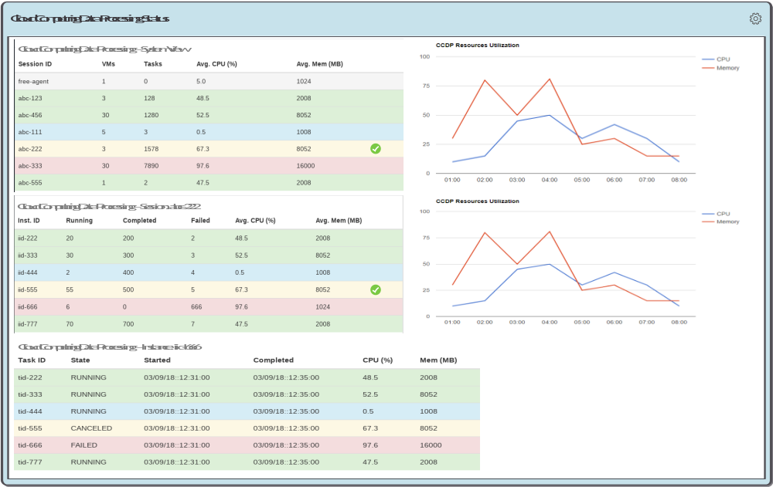
Zephyrus – Cloud & Task Management Tool
Resources Allocation View

Slide 5
Zephyrus – Cloud & Task Management Tool
Benefits
Cloud Agnostic Resource Allocation tool (supporting AWS, Azure, IBM etc.)
  Simplifies integration with widely used processing frameworks
Process Visibility
Ease of use compared to AWS
Ability to deploy docker containers acting as VMs
Load Balancing between VMs
Dynamic Allocation of Resources
  Provides a more flexible resource allocation schemes through API
  Simplifies the configuration and management of a cluster
    Removes the need to know how to use cloud provider’s resource management which could be very difficult and convoluted
Tremendous cost savings
  Could reduce operation costs significantly based on the actual processing resources needs by:
    Stopping resources that are not being used
    Provides running mode options allowing customers to choose best running mode

Slide 6
Demonstration

Slide 7
Zephyrus – Cloud & Task Management Tool
Actual Cost Comparison
Chauee Typical Usage Scenario
Service | Legacy Cost | 7H Cost
EC2 | $9,876.84 | $3,567.25
RDS | $0.00 | $556.32
Total Equiv. Monthly | $9,876.84 | $4,123.57
Sixty Users Eight Hours Shift Monthly Cost
Service | Legacy Cost | 7H Typical Cost | 7H Max Cost (*)
EC2 | $6,449.74 | $3,035.56 | $4,659.24
EBS | $515.29 | $403.37 | $403.37
RDS | $0.00 | $365.38 | $365.38
Total Monthly | $6,965.03 | $3,804.31 | $5,427.99
(*) Running all necessary instances 100% of the time due to support requirements

Slide 8
Zephyrus – Cloud & Task Management Tool
Future Investment
Mature prototype for a production environment
  Perform code review
  Add more formal testing procedures
  Add unit testing
  Perform stress testing
  Improve build system
Added Features
  Develop web-based configuration page
  Optimize current configuration approach
  Replace current heartbeat monitoring/reporting approach
  Improve task and thread management web based tool
Proposed effort is estimated at
  3 FTE for a year
  ~$700K

Slide 9

Zephyrus – Cloud & Task Management Tool
Additional Questions
Questions?
Oscar E. Ganteaume
Office: 703.665.7259
Cell: 703.655.3479
Oganteaume@LGSInnovations.com

